Slide 1

7 Segment and LCD interfacing with lpc2148

Slide 2
Course: ARM Processor & Applications
Course Outcomes (COs):
At the end of the course the student should be able to:
Discuss advanced microprocessor architecture and pipeline structure.
Write assembly language programs with a tradeoff between size and complexity and test it using development tools.
Develop an assembly level program for the given application using ARM or THUMB or both instruction set.
Discuss the concept of interrupt and their application.
Develop a C code for interfacing different ON/OFF board peripheral devices to LPC 2148 controller.

Slide 3
Introduction
Interfacing is a process of connecting devices together so that they can exchange information.
There are different I/O devices that can be connected.
Some examples are LED, LCD,Keypad,switch,7 Segment etc

Slide 4
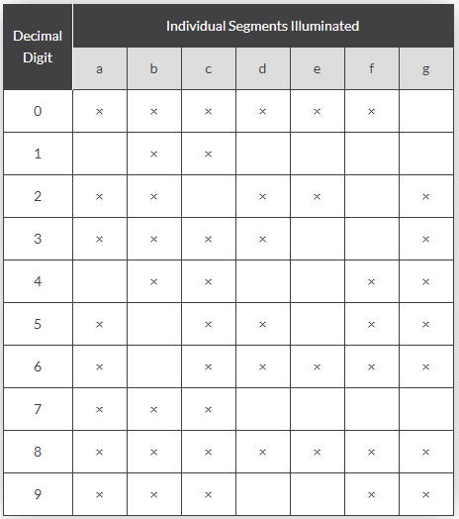
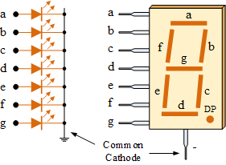

7 Segment display interfacing with LPC2148
31-03-2021

Slide 6
Algorithm
Set the pinsel register to gpio
Set the direction of the port pins
Select the segment
Clear the data
Send each data for numbers
Wait for sometime
Clear the data

Slide 7
Program
#include<lpc21xx.h> void delay(void); unsigned char i; unsigned int Disp[16]={0x003F0000, 0x00060000, 0x005B0000, 0x004F0000, 0x00660000,0x006D0000, 0x007D0000, 0x00070000, 0x007F0000,0x006F0000, 0x00770000,0x007C0000, 0x00390000, 0x005E0000, 0x00790000, 0x00710000 } int main() { IODIR0=0x30ff0000; // making po.16 to p0.23 and p0.28 to p0.29 output lines IOSET0=0x30000000; //selecting both segments IOCLR0=0x00ff0000; // clearing data while(1) { | for(i=0;i<10;i++) { IOSET0=Disp[i]; //sending data delay(); delay();delay();delay();delay();delay();delay(); IOCLR0=0x00ff0000; // clearing data } } } void delay(void) { unsigned long int j; for(j=0;j<650000;j++); }
31-03-2021
SCHOOL OF ELECTRONICS AND COMMUNICATION ENGINEERING

Slide 8
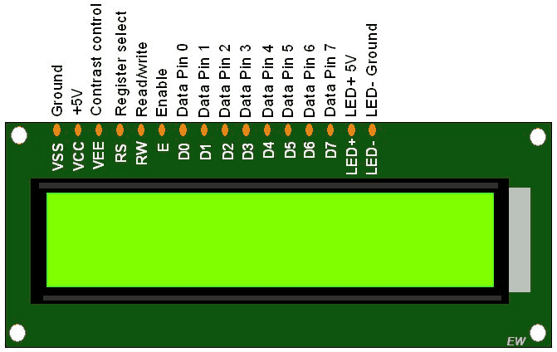
LCD Interfacing with LPC2148
HEX values | LCD commands
0x01 | Clear display
0x20 | Function set:4 bit, line 1,5x7 dots
0x28 | Function set:8 bit, line 2,5x7 dots
0x06 | Shift cursor to right
0x0e | Display on , cursor blinking
0x80 | Force cursor to beginning of 1st row
0xC0 | Force cursor to beginning of 2nd row
31-03-2021
SCHOOL OF ELECTRONICS AND COMMUNICATION ENGINEERING

Slide 9
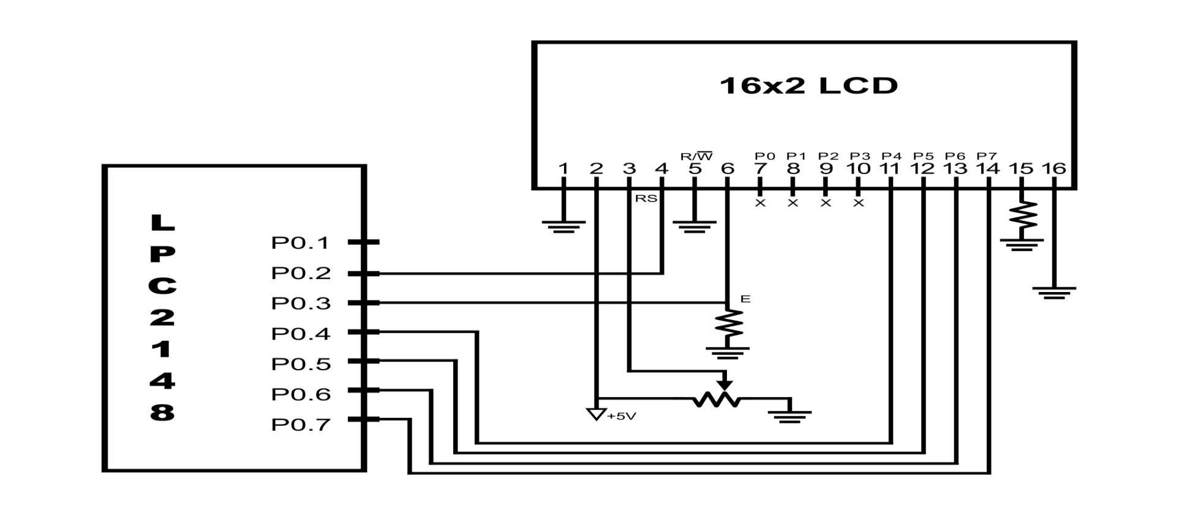
LCD connection with LPC2148
31-03-2021
SCHOOL OF ELECTRONICS AND COMMUNICATION ENGINEERING

Slide 10
Algorithm
Initialise pinsel0 to gpio
Set the direction of ports p0.2-p0.7 to output
Send lcd initialization commands
Send data to lcd

Slide 11
Algorithm for sending cmd/data
The common steps for sending both command or data are:
Mask lower 4-bits
Make RS=0/1 for cmd/data
Send data to the LCD port pins
Enable high to low transition to latch
Mask higher 4-bits
Shift the lower bits to left by 4bits
Make rs=0/1 for cmd/data
Send data to the LCD port pins
Enable high to low transition to latch

Slide 12
Keypad interfacing
The switches SW4 to SW19 are organized as 4 rows X 4 columns matrix. One end of all the switches are connected to port lines P1.20 – P1.23, which is configured as rows.
The other end of the matrix is connected to the port lines P1.16 – P1.19 which is configured as columns. The interface diagram for keypad is shown below.

Slide 13
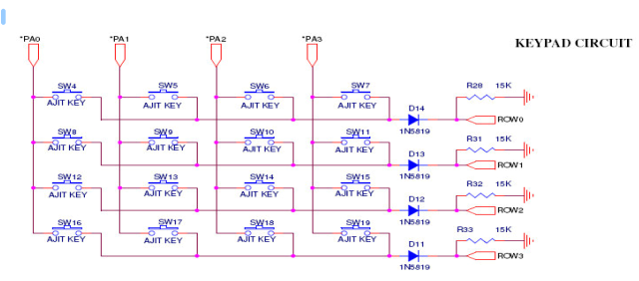

Slide 14
THANK YOU
31-03-2021
SCHOOL OF ELECTRONICS AND COMMUNICATION ENGINEERING

